Slide 1
Bertelsmann Cloud Curriculum
FAQs for Bertelsmann Employees
Overview
What is the Bertelsmann Cloud Curriculum? …………………………………………………………. | 3
How is the Cloud Curriculum structured? .……………………………………………………………. | 6
Which cloud roles are there? .…………………………………………………………………………. | 8
The Cloud DevOps Engineer……………………………………………………………………. | 9
The Cloud Solutions Architect…………………………………………………………………… | 10
The Cloud Product Owner………………………………………………………………………... | 11
Who are the learning providers? .……………………………………………………………………… | 16
Learning with Coursera …………………………………………………………………………… | 16
Learning with Udacity ……………………………………………………………………...……… | 19
Learning with Microsoft………. …………………...……………………………………………… | 22
Learning with Amazon Web Services…………...………………………………………………
Learning with Google………. …………………...………………………………………………
How do the learning providers differ from one another? ………………………………………...…… | 24

Slide 2
Bertelsmann Cloud Curriculum
FAQs for Bertelsmann Employees
Overview
Organizational .…………………………………………………………………………………….…...… | 27
Legal .……………………………………………………………………………………...………… | 28
Data Protection .……………………………………………………………………………….…… | 28
Peoplenet & Reporting .…………………………………………………………………………… | 29
Contact .……………………………………………………………………………………………... | 29

Slide 3
Bertelsmann Cloud Curriculum
FAQs for Bertelsmann Employees
The cloud is literally ubiquitous today. In addition to Data and Artificial Intelligence, cloud computing is one of the three pillars of the Bertelsmann Tech & Data Agenda. Especially in times of accelerated virtual networking, it connects us and allows us to access information and applications from anywhere. The cloud has become an integral part of how we collaborate, share data and do business now and in the future. The development of cloud expertise is therefore the way ahead for Bertelsmann.
With the Cloud Curriculum, Bertelsmann University provides all Bertelsmann employees with a premium-quality, flexible online learning experience that sets out to convey these skills and helps Bertelsmann use the cloud to transform and accelerate its businesses.
What is the Bertelsmann Cloud Curriculum?
What is the Bertelsmann Cloud Curriculum?
The Bertelsmann Cloud Curriculum is a curated digital learning offer for all Bertelsmann employees who want to either expand their existing competencies, or acquire new expertise, in the field of cloud computing. The Cloud Curriculum structures the field of cloud technology into three roles Cloud DevOps Engineer, Cloud Solutions Architect and Cloud Product Owner. For every role, a requirements profile listing specific skills has been defined and a matching learning program (‘learning path’) designed and constructed. The content is provided by top universities, leading cloud companies and subject experts. Upon successful completion of a course, participants can obtain a corresponding award or, depending on the chosen provider, take an exam leading to a professional industry certificate. The Cloud Curriculum offers every participant the opportunity to undertake further professional training in line with their current knowledge and to thus build upon their tech expertise and gain qualifications for both their current, but also new, professional tasks and responsibilities.
What is the Cloud Curriculum’s objective?
The aim of the Bertelsmann Cloud Curriculum is to build up cloud competencies at Bertelsmann; this includes the capabilities involved with of managing, designing, developing and deploying cloud-based solutions.

Slide 4
Bertelsmann Cloud Curriculum
FAQs for Bertelsmann Employees
What can participants expect of the Cloud Curriculum?
The Bertelsmann Cloud Curriculum is a flexible online learning experience with premium-quality standards and many interactive elements.
Participants benefit from a selected, well-structured and quality-assured digital learning curriculum with great practical relevance. Participants not only have the opportunity to exchange information about the challenges and best practices in communities powered by the respective learning provider, but also to work on their own projects. Thanks to the strong practical relevance, the learning content can be used in everyday professional life.
What topics does the Cloud Curriculum cover?
The selection of topics covers the entire ‘Technology-to-Business’ spectrum, and ranges from Software Development, to Solution Design, to Product and Portfolio Management. Furthermore, courses on basic tech skills, such as an introduction to programming, are also offered.
What are the learning targets?
The learning targets for each role were formulated together with experts of the Bertelsmann IT community – these targets are based on the requirements which practice places on each role profile. The learning targets for the individual roles are described in the role descriptions (pp. 8-14).
Who can register?
The Bertelsmann Cloud Curriculum is open to all Bertelsmann employees who want to undertake further training or want to intensify their knowledge in the area of cloud technology. The prerequisites vary according to the objectives of the learning path and can be taken from the individual role descriptions (pp. 8-14).

Slide 5
Bertelsmann Cloud Curriculum
FAQs for Bertelsmann Employees
What are the prerequisites for successful participation?
Key elements for successful participation are one’s own initiative and the desire to learn and discover.
The Bertelsmann Cloud Curriculum offers participants many individual ways to undertake further training and to build up their data expertise. Each individual has to decide which is the right path for him or her. The Bertelsmann University has lots of comprehensive information material available. Anyone who is potentially interested should ask, and find the answer to, the following questions:
Which cloud role is the right one for me?
How much time can I invest in my professional training?
Which learning provider will suit me best?
Which courses within a learning path do I need?
How much money would I like to invest?
What types of training are available?
Web-based training (WBT): Both Coursera and Udacity use mainly classic recorded online trainings that you can work through on your own and at your own pace. In addition, project work and peer communities will promote exchange over learning content and challenges and help you deepen your practical skills. After purchasing a license for either Coursera (including all Google Cloud trainings) or Udacity, you will be granted access to the provider’s content catalog for a fixed amount of time to complete your studies starting from your activation date.
(Virtual) Instructor-led trainings: AWS and Microsoft typically use live trainings in a private Bertelsmann-only cohort environment and delivered by a certified trainer. Trainings have a duration of 1 – 5 working days and are comprised of a mixture of theory and practical exercise. Through peoplenet, you can also access a collection of the free-of-charge self-study resources to deepen your skills. This is particularly recommendable if you are studying towards for a professional certificate exam.
The following image provides an overview of the types of training available for each role

Slide 6
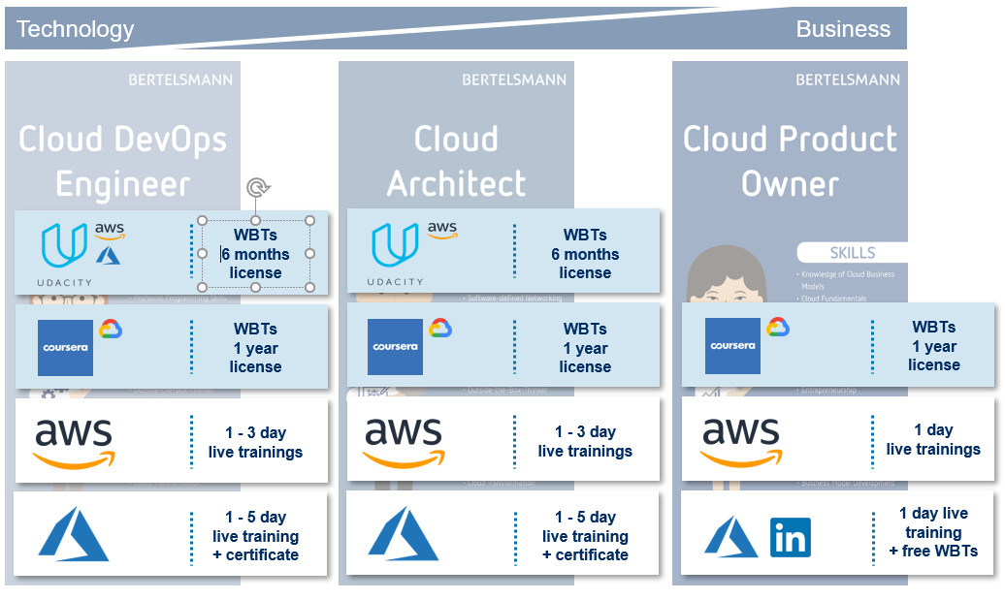
Bertelsmann Cloud Curriculum
FAQs for Bertelsmann Employees
How can I book a license or a live training?
Bertelsmann employees can book their chosen training format independently via peoplenet. The supervisor’s approval is automatically requested during registration. As soon as the supervisor has given his or her approval, the employee will receive further information on how to start the license or course.
Where does the program take place?
All programs take place 100% online. Please note that in the context of the Covid-19 pandemic, all instructor-led trainings are delivered virtually. Hence, participants can work from anywhere, as long as they have a functioning internet connection. Live trainings are available in various time zones.
How up-to-date is the providers’ training or course content?
The learning content is regularly updated by the providers and is thus right up-to-date.

Slide 7
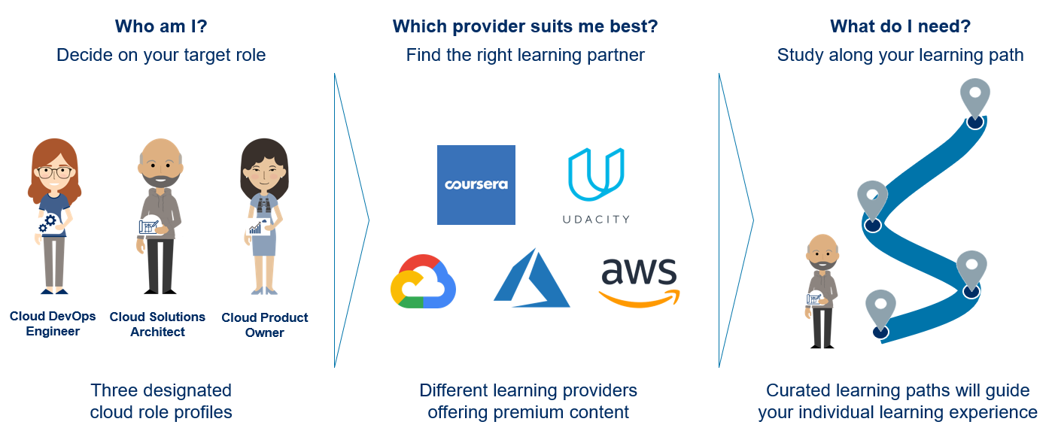
Bertelsmann Cloud Curriculum
FAQs for Bertelsmann Employees
How is the Bertelsmann Cloud Curriculum structured?
The Cloud Curriculum consists of three steps:
1) Who am I?
Together with corporate IT and divisional subject matter experts, Bertelsmann University has defined three role profiles across the area of cloud computing. Just as with the Bertelsmann Data Curriculum, the roles encompass the entire ‘Technology-to-Business’ spectrum, including:
Continuous development and deployment of software, reliability, automation ("Cloud DevOps Engineer")
Analysis of requirements and infrastructure, solution design ("Cloud Solutions Architect")
Development of cloud business models, portfolio and strategy, market research, monitoring of business metrics ("Cloud Product Owner")
You can find more details on the Bertelsmann University website:
www.bertelsmann-university.com.

Slide 8
Bertelsmann Cloud Curriculum
FAQs for Bertelsmann Employees
2) Which provider suits me best?
For the Cloud Curriculum, Bertelsmann University works together with five different learning partners:
• Coursera
• Udacity
• Microsoft
• Amazon Web Services
• Google
Each learning provider has their own profile and differs, for example, in terms of content, time investment and price. Besides the established Bertelsmann University learning partners, Coursera and Udacity, this time there are also offers from the three leading Cloud companies: Microsoft, AWS and Google. This way, both provider-agnostic and provider-specific learning content is available for learners to chose from. This diversity allows participants to pick an offer that is suited to their individual learning needs and the technological environment at their organization. You will find an overview of the most important differences between the learning partners in the document Provider Comparison.
3) What do I need?
In order to provide the knowledge and skills required for a role, our learning partners have built learning paths on the basis of each role profile. Each learning path contains a curated collection of online courses.
The potential learning effort depends on the level of knowledge of the learner. The description of the individual learning paths, including course information, can be found on the Bertelsmann University website: www.bertelsmann-university.com.

Slide 9
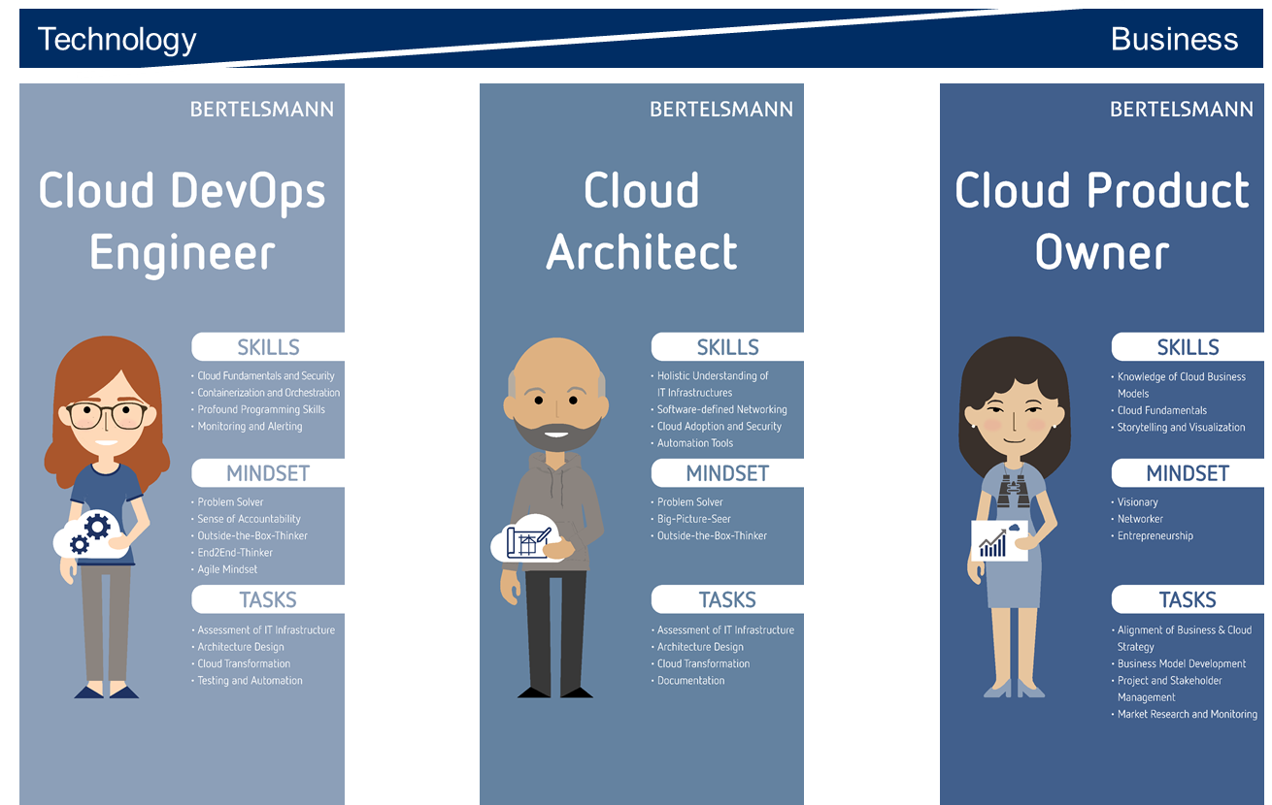
Bertelsmann Cloud Curriculum
FAQs for Bertelsmann Employees
Which cloud roles are there?
In the following, you will find the respective role profile descriptions, requirements and learning targets for each cloud role.
Overview
There are three cloud roles: Cloud DevOps Engineer, Cloud Solutions Architect and Cloud Product Owner.
In order to choose a suitable role, interested participants may use the description, as well as the stated prerequisites as guidance.

Slide 10
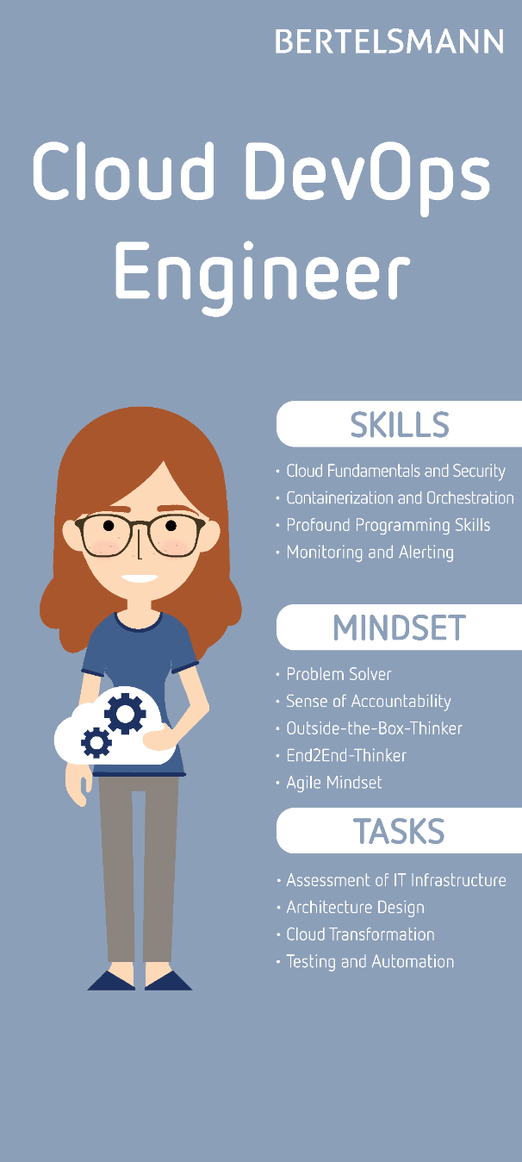
Bertelsmann Cloud Curriculum
FAQs for Bertelsmann Employees
The Cloud DevOps Engineer
Role description: A professional Cloud DevOps Engineer is responsible for efficient development operations that aim to optimize service reliability and delivery speed.
Using Cloud platforms they ensure continuous development and deployment of software. They monitor CPU and memory usage as well as services and are able to manage incidents and learn from them.
Cloud DevOps Engineers aim to continuously deliver value in end-to-end process automation.
Prerequisites: Distinct knowledge of software development and scripting, knowledge of various server systems, data management skills, the ability to use a variety of open source technologies and tools.
Learning targets:
Cloud Fundamentals
Knowledge of different types of Cloud
Cloud Security and Data Security
Software-defined Networking
Containerization and Orchestration
Infrastructure as Code and System Hygiene
OS Know-how
Profound Programming Skills
Monitoring and Alerting

Slide 11
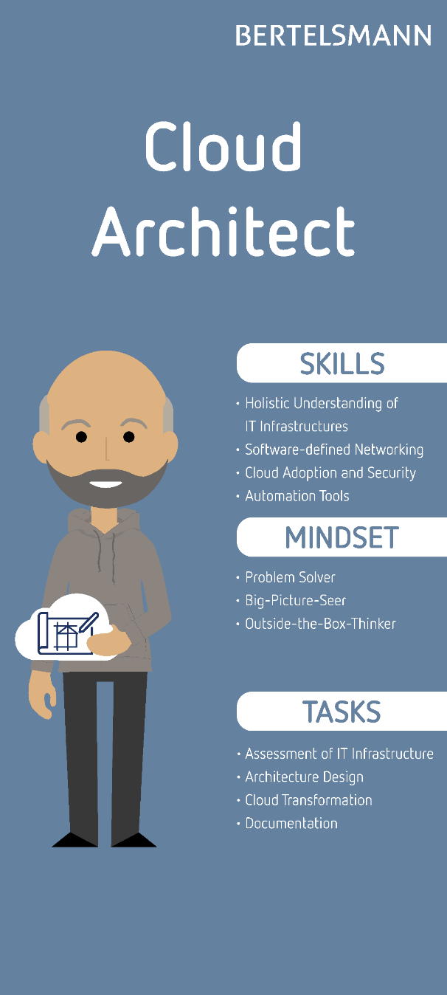
Bertelsmann Cloud Curriculum
FAQs for Bertelsmann Employees
The Cloud Solutions Architect
Role description: Cloud Solution Architects are responsible for solving complex business problems using cloud technologies. They translate the technical requirements of a project into the architecture and design of a solution.
The Cloud Solution Architects work closely with other roles of the technology teams to ensure that the best possible Cloud technology is used.
Prerequisites: Pronounced knowledge of IT infrastructures: Server virtualization, network and storage technologies
Learning targets:
Cloud Security
Software-defined Networking
Containerization and Orchestration
Holistic understanding of IT Infrastructures
Cloud Adoption
Automation Tools

Slide 12
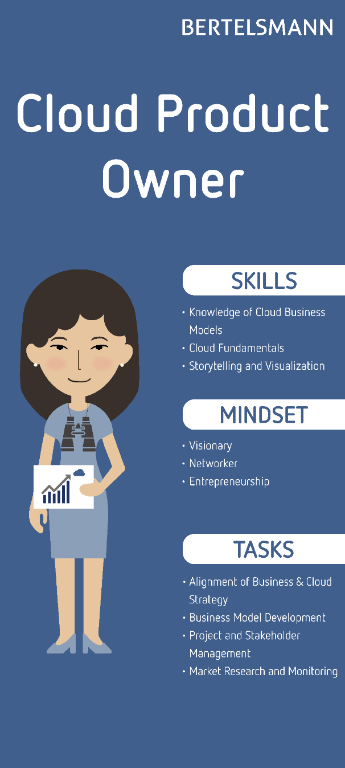
Bertelsmann Cloud Curriculum
FAQs for Bertelsmann Employees
The Cloud Product Owner
Role description: Cloud Product Owners understand and promote the acceptance of the Cloud. They observe the market with regard to competitors, trends and customers and use them to derive strategies for portfolio development and motivate technological transformation. They are able to communicate effectively and convince on the basis of business-relevant use cases and analysis results.
Cloud product owners guide strategic portfolio developments and are in contact with various analysts and consulting companies in order to identify technology trends at an early stage.
They drive product and service development and involve cloud solution architects for technical implementation. They take care of the overall organization of processes and applications and optimize their interaction.
Prerequisites: Very good, customer-driven business understanding with strong communication and marketing skills.
Learning targets:
Profound understanding of the potential of digital technologies
Knowledge of Cloud-based business models
Alignment of business and Cloud strategy
Cloud Fundamentals
Management of requirements
Storytelling and visualization
Project and stakeholder management

Slide 13
Bertelsmann Cloud Curriculum
FAQs for Bertelsmann Employees
Who are the learning providers?
In the context of the Cloud Curriculum, Bertelsmann University works together with five learning partners: Coursera, Udacity, Microsoft, Amazon Web Services and Google.
The criteria for the selection of these particular learning providers were the content quality, the didactics and usability of online and virtual instructor-led classes as well as industry relevance.
Learning with Coursera
What is Coursera?
The Coursera learning platform provides transformational learning online, taught by top instructors from 190+ of the world’s leading universities (including Stanford, Yale, and IESE) and organizations (including Google, BCG, and Deeplearning.ai). Coursera courses focus on essential skills across data, technology and business.
Why learn with Coursera?
Refresh your education and keep your competitive edge
Become better informed on a variety of topics
Academically-orientated: Receive certificates from renowned top universities
Make consistently flexible use of your time
Use of Coursera certificates e.g. on your LinkedIn profile for personal qualification
Can I complete the course at my own pace?
Yes, Coursera offers on-demand learning. Most Coursera courses have personalized deadlines that begin when you enroll on a course. There is no grade penalty for a missed deadline, so you can work at your own pace if you cannot, or do not want to meet the suggested deadlines. Some courses have sessions, which means everyone has the same deadlines to help ensure there are enough peer review assignments for you to review and have reviewed. If you fall behind, you will need to switch sessions in order to change your deadlines.

Slide 14
Bertelsmann Cloud Curriculum
FAQs for Bertelsmann Employees
What is a Coursera course like?
Coursera courses include recorded auto-graded and peer-reviewed assignments, video lectures, and community discussion forums. When you complete a course, you will be eligible to receive a shareable electronic course certificate.
What is the difference between a course and a specialization?
A Coursera specialization is a series of related courses designed to help you master a specific topic. Some shorter specializations include as few as three courses and only take a few months to finish. Longer specializations can include ten or more courses and take up to a year. When you finish a specialization, you get a specialization certificate. You will also get course certificates for each course you complete in a specialization.
Do I have contact with other learners?
Taking a course will make you part of a community of over 46+ million global learners who want to refresh their education and keep their competitive edge. Discussion forums form part of your course, but whilst participation is encouraged, it is voluntary. You will have the opportunity to exchange feedback on assignments and discuss ideas in your course discussion forums as you work together to master new concepts and best practices.
How long will each course take?
Coursera courses have been designed to allow you to work at your own pace with bite-sized sessions and a self-paced learning model. The time varies by each course and when you click into a course it has a very detailed description to help you better choose the course that fits you. Coursera keeps lectures and lessons short - with only a few minutes each - so learners can make meaningful progress in just a few minutes a day.
Generally courses can take between 1-6 weeks to complete. The average length of a course is 20 hours and is designed to fit around your schedule.
Can I also learn on a mobile device?
You can learn at any time on your computer or on the Coursera app (available in Android and iOS app stores). 95% of the courses on Coursera can be taken from beginning to end on your mobile phone, laptop or tablet.

Slide 15
Bertelsmann Cloud Curriculum
FAQs for Bertelsmann Employees
What is the program language?
The program language of all courses is English. For 95% of the courses, subtitles are available in a multitude of languages.
How can I earn a course certificate?
To earn a course certificate, you need to pass all the assessments included in the course. If the course includes peer review assignments, you will need to review other assignments, as well as have your own assignments reviewed and passed.

Slide 16
Bertelsmann Cloud Curriculum
FAQs for Bertelsmann Employees
Learning with Udacity
What is Udacity?
Udacity is a private online education provider. The Udacity online education platform provides practical tech-focused online courses in collaboration with leading tech companies. Udacity’s Nanodegree programs are co-created with industry leaders and are designed for lifelong learners. Udacity Nanodegree programs focus on jobs related to Software Development, Data Science, Cloud Computing, Artificial Intelligence and more.
Why learn with Udacity?
Job-related projects by industry experts
Focus on business-relevant skills
Get useful help from mentors
Benefit from the exchange with the community
Nanodegrees are well received in the international tech domain
Can I complete the course at my own pace?
There are two start-dates per year. Participants begin and end the course together. In between, the participants’ time is at their own disposal and they can work independently and at their own pace.
What is an Udacity course like?
Udacity courses are highly interactive with activities, such as quizzes and exercises, interspersed between short videos and interviews with instructors and industry experts. After a lesson there will usually be a problem set with exercises for you to reaffirm that you have learned the material. Just as with the quizzes and videos, you can take them as many times as you like. One of the highlights around learning with Udacity is the capstone project included at the end of a program which you can later add to your portfolio.

Slide 17
Bertelsmann Cloud Curriculum
FAQs for Bertelsmann Employees
Can I also learn on a mobile device?
You can learn at any time on your computer. The Nanodegree learning content is extensive and requires a desktop computer. However, individual videos can be downloaded and watched on a mobile device.
What is the program language?
The program language of all Udacity Nanodegree programs is English. All Udacity course videos have English subtitles.
What is a Nanodegree respectively a Nanodegree program?
A Nanodegree program is an innovative online curriculum path. Every program provides a clear end goal, and the ideal path to get the students there. Courses are built with industry leaders, like AWS and Microsoft, and are taught by leading experts on the respective subjects. While progressing through a Nanodegree, students benefit from personalized mentoring for technical support, as well as detailed project reviews and feedback. Graduates earn an industry-recognized certificate.
How long will the Nanodegree program take?
The duration and time commitment for completing our Nanodegree programs varies depending on the requirements for the specific program. In order to receive the Nanodegree, the program must be completed within a certain period of time (usually 6 months). The amount of time required varies depending on the complexity of the program and individual previous knowledge.
All the Nanodegree programs include:
Real-world projects form industry experts With real-world projects and immersive content built in partnership with top-tier companies, you will master the tech skills which companies want.
1-on-1 technical mentor You will be allocated a knowledgeable mentor who guides your learning and is focused on answering your questions, motivating you, and keeping you on track.
Flexible learning program You will get a custom learning plan tailored to fit in with your busy life. Learn at your own pace and reach your personal goals on a schedule that works best for you.

Slide 18
Bertelsmann Cloud Curriculum
FAQs for Bertelsmann Employees
Do I need to take each course in the Nanodegree program in order to receive a Nanodegree credential?
No. All you need to do to earn a Nanodegree credential is to submit completed projects that pass required specifications. If you already have the skills you need to complete a project, you can submit it immediately and move on to the next project in your Nanodegree program portfolio.
How can I earn a Nanodegree certificate?
Udacity credentials will be awarded based on the successful completion of all the required components of a program. After successfully completing your projects, your identity will be verified and you may be asked to do an exit interview. Upon successful completion of this process, you will receive an official Udacity Nanodegree certificate of achievement. You will then be able to view, print, and share your certificate/badge through your Udacity account.

Slide 19
Bertelsmann Cloud Curriculum
FAQs for Bertelsmann Employees
Learning with Microsoft
Why learn with Microsoft?
If you or your organization uses Microsoft Azure cloud technology, Microsoft trainings will give you the opportunity to qualify as an expert specifically for Microsoft-based cloud applications and platforms. Taking a Microsoft original learning path is the easiest way to study towards an officially accredited Microsoft professional certification.
Can I complete courses at my own pace?
Live trainings are delivered virtually over a fixed period of time. You will need to attend the full length of the training to obtain a certificate of completion. All Microsoft trainers are experienced in supporting students with differing learning needs and speed.
What is the program language?
Live trainings are available in German and English. Should you require training options in other languages, please reach out to us at university@bertelsmann.com. Additional study material is available in a wide range of languages.
What is a Microsoft-taught course like?
You will be studying in a private cohort alongside your Bertelsmann peers and be able to exchange challenges and learnings in a like-minded group. In a live training setting, a Microsoft-certified trainer will provide theoretical input, exercises and 1-on-1 guidance.
How long will each course take?
Courses are between 1 and 5 days long. You may wish to deepen your skills using the extensive self-study material provided free of charge on peoplenet. Especially if you are looking to take a professional certification exam, complimentary self-study is encouraged depending on your levels of proficiency and experience.
Can I also learn on a mobile device?
You will need to log on via a desktop PC or Laptop to be able to take the exercises and work on projects.
How can I obtain an accredited Microsoft certificate?
If you would like to take a professional certification exam, you can pick your preferred exam date by registering via …. Bertelsmann University provides free-of-charge exam vouchers on a first-come-first-serve basis. Please reach out to XXX to get yours.

Slide 20
Bertelsmann Cloud Curriculum
FAQs for Bertelsmann Employees
Learning with Amazon Web Services
Why learn with AWS?
If you or your organization uses AWS cloud technology, AWS original trainings will give you the opportunity to qualify as an expert specifically for AWS cloud applications and platforms.
Can I complete courses at my own pace?
Live trainings are delivered virtually over a fixed period of time. You will need to attend the full length of the training to obtain a certificate of completion. All AWS trainers are experienced in supporting students with differing learning needs and speed.
What is the program language?
Live trainings are available in German and English. Should you require training options in other languages, please reach out to us at university@bertelsmann.com. Some self-study material is available in a wider range of languages.
What is a AWS-taught course like?
You will be studying in a private cohort alongside your Bertelsmann peers and be able to exchange challenges and learnings in a like-minded group. In a live training setting, a Microsoft-certified trainer will provide theoretical input, exercises and 1-on-1 guidance.
How long will each course take?
Courses are between 1 and 3 days. You may wish to deepen your skills using the extensive self-study material provided free of charge on peoplenet.
Can I also learn on a mobile device?
You will need to log on via a desktop PC or Laptop to be able to take the exercises and work on projects.

Slide 21
Bertelsmann Cloud Curriculum
FAQs for Bertelsmann Employees
Learning with Google
All Google Cloud Platform courses in this Curriculum are brought to you by Coursera. Please see above for information on learning with Coursera (p.-.)

Slide 22
Bertelsmann Cloud Curriculum
FAQs for Bertelsmann Employees
How do the learning providers differ from one another?
All five providers – Coursera, Udacity, Microsoft, AWS and Google – have constructed learning paths, which differ with respects to time investment, cost, the scope of the subject offer and the degrees/qualifications.
Whoever is the correct provider is determined by the learner’s individual needs.
Who provides the content?
Coursera: The content is provided by top universities and leading technology companies.
Udacity: The content is provided by leading technology companies and Udacity experts.
Microsoft: The content is provided by Microsoft and delivered live by selected and certified Microsoft trainers
AWS: The content is provided by Amazon Web Services and delivered live by selected and certified AWS trainers
Google: The content is provided in cooperation with Google and delivered on Coursera
How can I book an offer and how much does it cost?
All licenses and courses can be booked through peoplenet.
The prices for each offer are as follows:
Coursera: 339 euros per annual license
Udacity: 1.950 euros per 6-month license
Microsoft: XXX euros administration fee per 1-day/3-day virtual instructor-led class
AWS: XXX euros per 1-day/3-day virtual instructor-led class
Google: 339 euros per annual Coursera license
How long is the time period for a license?
Coursera: The license on the Coursera platform is valid for one year from the date of activation on peoplenet.
Udacity: The license is valid for six months, commencing from the start of the course.
Microsoft: No license needed
AWS: No license needed
Google: 339 euros pro per annual Coursera license via Coursera

Slide 23
Bertelsmann Cloud Curriculum
FAQs for Bertelsmann Employees
To which content do the participants have access?
Coursera: Participants have access to all curated learning paths for all cloud roles and, furthermore, to the entire Coursera catalog.
Udacity: Participants have access to the booked Nanodegree program.
Microsoft: Participants have access to the booked virtual instructor-led class + additional self-study material.
AWS: Participants have access to the booked virtual instructor-led class + additional self-study material.
Google: Participants have access to all Google-specific curated learning paths for all the cloud roles and, furthermore, to the entire Coursera catalog.
When can I start to learn?
Coursera: There are four start dates per year. The dates can be found on the Bertelsmann University website.
Udacity: There are two start dates per year. The dates can be found on the Bertelsmann University website.
Microsoft: With their registration on peoplenet, participants can choose their preferred course date.
AWS: With their registration on peoplenet, participants can choose their preferred course date.
Google: There are four start dates per year on Coursera. The dates can be found on the Bertelsmann University website.
Do I have to take all the courses on a learning path?
Coursera: No, however one course, or a specialization (= a series of courses), must be completed in order to gain a certificate.
Udacity: No, however all the projects in the respective Nanodegree must be completed in order to be awarded a Nanodegree.
Microsoft: No, however, we encourage that all relevant courses are taken if participants pursue an accredited Microsoft certification.
AWS: No, you may pick and choose the courses that suit you best and continue with the next course on your learning path on a later stage, if preferred.
Google: No, however one course, or a specialization (= a series of courses), must be completed in order to gain a certificate.
Do the courses within a learning path build upon each other?
Coursera: No. The learning paths are a curated collection of courses which do not build upon one another. Basically, the individual online courses can be taken independently of each other.
Udacity: No, the Nanodegrees do not build on each other. A Udacity learning path consists of various Nanodegree programs which also do not build upon one another. Basically, the individual Nanodegree programs can be taken independently of each other.
Microsoft:
AWS:
Google: No. The learning paths are a curated collection of courses which do not build upon one another. Basically, the individual online courses can be taken independently of each other.

Slide 24
Bertelsmann Cloud Curriculum
FAQs for Bertelsmann Employees
How do I ensure that the course is appropriate for my skill level?
Each of the learning providers lists the prerequisites for successful participation in the respective course description.
Which certificates can be gained?
Coursera: Upon completion of a course, participants will receive a certificate from the university/company which offered the course. In the case of a specialization, all the included courses must be completed.
Udacity: Participants will be awarded an Udacity Nanodegree upon completion of all the courses and projects.
Microsoft: Participants are encouraged to work towards a Microsoft certification exam based on their role. Available exam dates and details are available through https://www.microsoft.com/en-us/learning/browse-all-certifications.aspx. Bertelsmann University provides a limited number of free-of-charge exam vouchers to interested participants on a first-come-first-serve basis.
AWS: Upon completion of a course, participants will receive a certificate of completion.
Google: Upon completion of a course / specialization, participants will receive a certificate of completion.
Do courses have to be completed within a specific time period in order to gain a certificate?
Coursera: No.
Udacity: Yes. A Nanodegree program should be completed within six months in order to gain the Nanodegree. It is, however, possible to purchase the license and extend it after the six months have expired.
Microsoft: Live instructor-led trainings have a fixed time and must be completed as scheduled.
AWS: Live instructor-led trainings have a fixed time and must be completed as scheduled.
Google: No.
How much time do employees need to plan-in?
The learning effort depends on the individual’s study speed, previous knowledge and the personal course choice:
Coursera: Each course and each specialization has an individual duration. Basically, it takes between one to six weeks to complete a course. Each course takes about 20 hours.
Udacity: Each Nanodegree has an individual duration. Participants have a maximum of six months to complete the program. On average, an investment of between five and ten hours per week is necessary.
Microsoft: Learning paths consist of virtual instructor-led classes of a duration of 1 – 5 days each. Additional self-study may be required, especially when training towards an accredited Microsoft certification.
AWS: Learning paths consist of virtual instructor-led classes of a duration of 1 – 3 days each. Additional self-study may be required depending on expertise.
Google: Each course and each specialization has an individual duration. Basically, it takes between one to six weeks to complete a course. Each course takes about 20 hours.

Slide 25
Bertelsmann Cloud Curriculum
FAQs for Bertelsmann Employees
Are the providers accredited educational institutions?
Coursera: Coursera has a mix of accredited and non-accredited courses, and works with certain colleges and universities to offer specializations in trending subjects. Many of the on-demand courses on Coursera are not accredited, but Coursera’s content comes from prestigious universities that are accredited.
Udacity: No, Udacity is not an accredited educational institution. It is a private online education provider and does not confer any degrees.
Microsoft: No, Microsoft is not an accredited educational institution. It is a private online education provider and does not confer any degrees.
AWS: No, AWS is not an accredited educational institution. It is a private online education provider and does not confer any degrees.
Google: No, Google is not an accredited educational institution. It is a private online education provider and does not confer any degrees.
What is the program language?
Coursera (including Google): Each course is offered in English. For 95% of the courses, subtitles in a number of other languages are available.
Udacity: Each course is offered in English and has English subtitles.
Microsoft: Courses are available in English and German, depending on the course date. For classes in other languages, please reach out.
AWS: Courses are available in English and German, depending on the course date. For classes in other languages, please reach out.
What are the technical requirements for using the offers?
Participants must have access to a computer or a mobile device.:
Coursera (including Google): The learning content is available through the coursera platform.
Udacity: The learning content is not available through the Udacity platform
Microsoft: System requirements will be shared with the registered participants prior to the class.
AWS: No specific software requirements or admin rights are needed. Virtual training is delivered on the platform GoToTraining (GTT). Participants can either install the app or connect via a URL They can test their connection to GTT prior to the session.
Is there an overview of the learning providers with more information?
On Bertelsmann University’s website, you will find a comparison of all five learning partners, showing individual features and differences at a glance. (LINK ZUM DOKUMENT)

Slide 26
Bertelsmann Cloud Curriculum
FAQs for Bertelsmann Employees
Organizational
Legal
Is the time spent learning the lesson content seen as working time?
Arrangements with regards to working hours will need to be individually agreed on-site with the respective supervisor. Thus, the regulation is made in consultation with the local human resources department.
Data Protection
What rights do employees have in connection with data protection?
As data subjects, participants have a right of access, rectification, deletion, restriction of processing, data transferability and a right of objection. Participants also have the right to lodge a complaint with the applicable data protection authority.
The contact partners for data protection can be found here:
Udacity: https://eu.udacity.com/legal/gdpr-compliance
Coursera: privacy@coursera.org.
Microsoft:
AWS:
Google: privacy@coursera.org.
The contact partner for data protection at Bertelsmann can be reached at the following address: datenschutz@bertelsmann.de
Which personal data are transmitted by Bertelsmann and vice-versa?
The first and last name, email address and peoplenet-ID are automatically transmitted from Bertelsmann to the Cloud Curriculum providers. The data transfer between Bertelsmann and the providers exceeds the European regulations on data security, as some of the providers are localized in the US. In order to make the transfer of personal data secure and legal, extensive data protection agreements are in place between Bertelsmann and the providers.

Slide 27
Bertelsmann Cloud Curriculum
FAQs for Bertelsmann Employees
How secure is the data?
The data protection corresponds to the European data protection regulations and the strict German standards. As with all the other training course offers, supervisors and managers can see which courses are on the respective employee’s training plan and have been completed. However, they are not given any information about the courses or the progress in those courses which have not been completed.
peoplenet & Reporting
Will the participation be uploaded to the employee’s peoplenet learning plan/learning history?
Bertelsmann University will assign the courses to the learning record of all the employees who have provided their peoplenet-ID in the application process.
Coursera: Upon registration, the license is added to the training plan. After the courses are completed, they are transferred to the peoplenet learning history.
Udacity: Upon registration, the license is added to the training plan. After completion of the Nanodegree, this will be transferred to the peoplenet learning history.
Microsoft: Upon registration, the course is added to the training plan. Completed classes are tracked in the peoplenet learning history.
AWS: Upon registration, the course is added to the training plan. Completed classes are tracked in the peoplenet learning history.
Google: Upon registration, the license is added to the training plan. After the courses are completed, they are transferred to the peoplenet learning history.
Contact
Who can I turn to if I have more questions?
For Bertelsmann-specific questions (e.g. working time, peoplenet), please contact your local human resource department.
For general questions on the course program, and for user support, please contact: university@bertelsmann.com
Coursera: Visit https://learner.coursera.help and make sure you are logged into your account to start a live chat with one of the Coursera Learner Support agents, or contact clientsupport@coursera.org.
Udacity: Visit https://www.udacity.com/contact
Microsoft
AWS: aws-dach-training@amazon.com
Google: Visit https://learner.coursera.help and make sure you are logged into your account to start a live chat with one of the Coursera Learner Support agents, or contact clientsupport@coursera.org.

